Slide 1

Almost Almost There!!
Unit 9 – Correlation and Regression
Your Ready-to-be-done-with-slides Professor Colton

Slide 2
Unit 9 - Outline
Correlation and Regression
Intro
Scatterplots
Correlation
Regression Line
Predictions
Evaluating Predictions

Slide 3
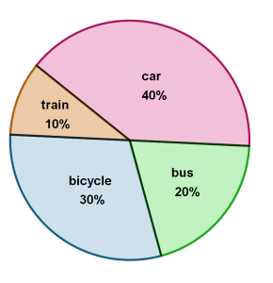
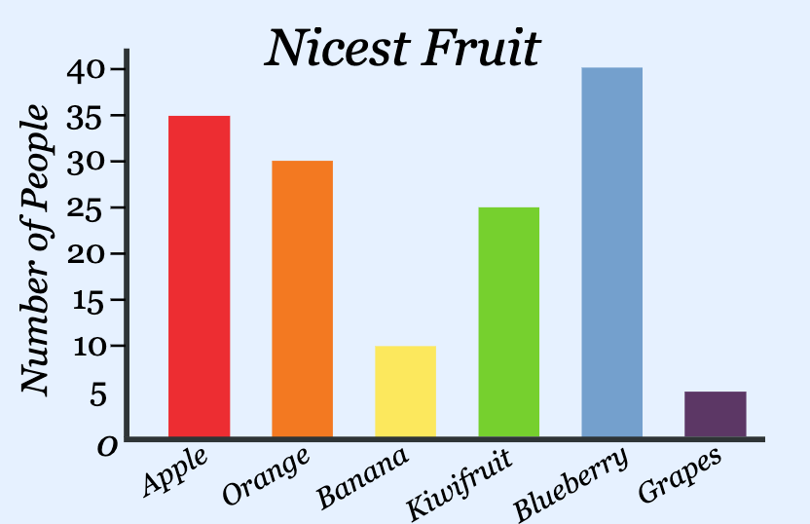
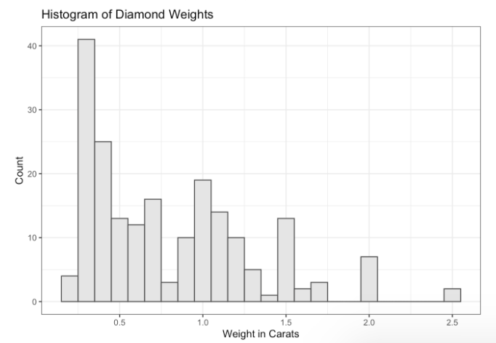
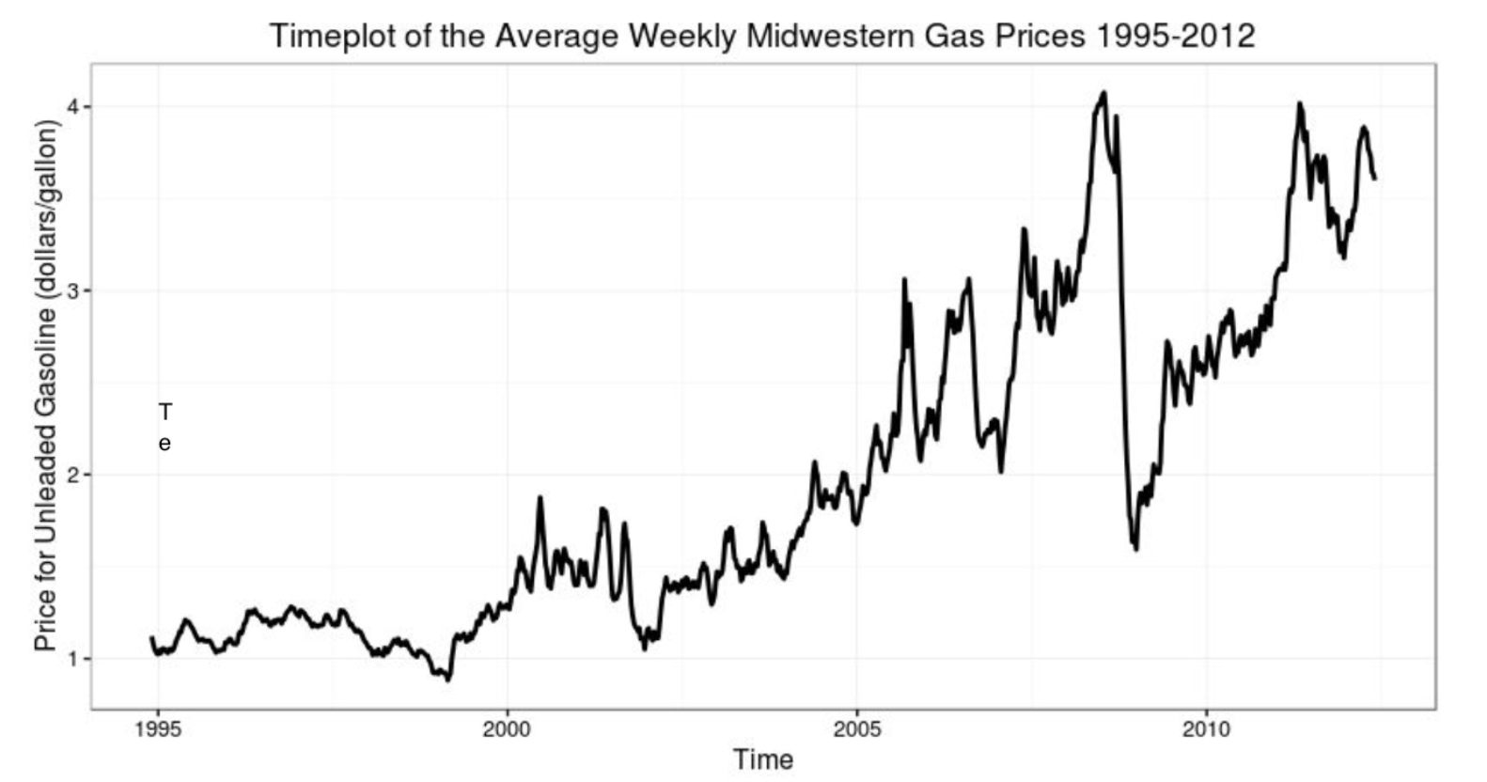
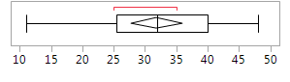
Review + New
We have studied how to display and describe distributions depending on the type of data
Qualitative (Categorical) Data
Non-Numerical data with different categories.
Ex) States, letter grades, class standing, etc.
Here we can describe the mode (the most common category)
Quantitative Data
Numerical data, counts or measurements
Arithmetic operations such as adding and averaging make sense
Ex) Income, GPA, Height, Weight, etc.
With line graphs, we described the trend and seasonal variation
With histograms and boxplots, we described the SOCS! Shape, Outliers, Center and Spread
Also numerical summaries like mean, median, SD, IQR, etc.
(Other than the line graph) these displays were all for ONE variable!
Now we are going to display and describe the relationship between TWO QUANITITATIVE variables!

Slide 4
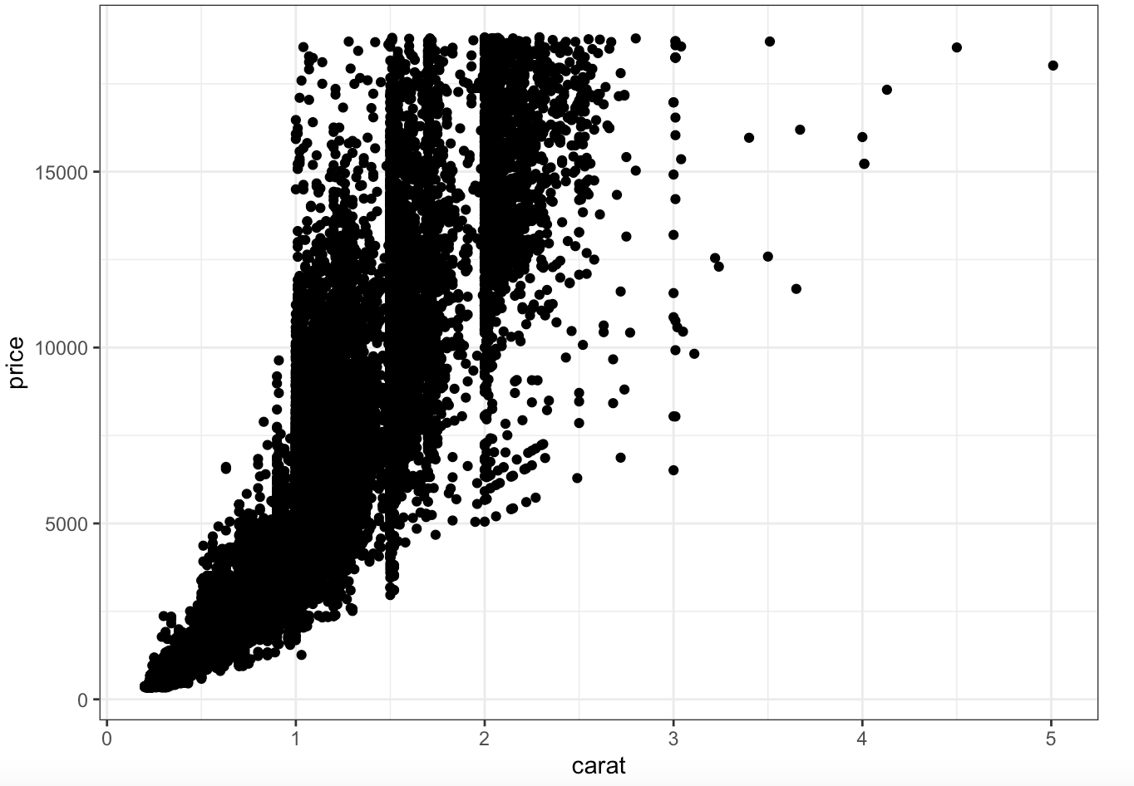
Scatterplots
Scatterplot
Displays the relationship between two quantitative variables measured on the same individuals.
Useful to determine if an association exists!
So is there a pattern where some values of one variable tend to occur with some values of the other variable
Example) Smaller carat diamonds tend to have lower prices, and as the carat increases prices tend to increase as well
In some situations, such as experiments or studies, we want to see if one variable explains the variability of the other.
Can we use one variable to predict the other?
Example) If I have a 2.5 carat diamond, how much will it cost?
Setup
Axes
The explanatory (independent) variable goes on the X (horizontal) axis
The response (dependent) variable goes on the Y (vertical) axis
Example) How large a diamond is impacts how much it costs! So the price would be the dependent (Y) and carat independent (X)
If there is no clear explanatory/response relationship, then it does not make a difference which variable goes on which axis.
Points
Every individual in the data set has two measurements, one for each variable, and each individual appears as a dot on the plot.
Every point is an ordered pair (x,y)

Slide 5
LCQ – Explanatory vs Response
Problem: Determine which variable would go on the X-axis and the Y-axis of the scatterplot.
The amount of time spent studying for an exam and the exam score
The weight and height of a person
The amount of yearly rainfall and crop yield
A student’s math SAT score and the verbal SAT score

Slide 6
LCQ – Explanatory vs Response
Problem: Determine which variable would go on the X-axis and the Y-axis of the scatterplot → It is important to get this correct because it will impact the analyses we will learn later!!
Strategy→ Think in terms of dependent and independent variables (response vs explanatory) ; or maybe chronologically, which comes first)
The amount of time spent studying for an exam and the exam score
X = Time spend studying → Chronologically, you study before the exam. So this would be the independent
Y = Exam score → Exam score definitely depends on the amount of time you spend studying
The weight and height of a person
X = Height → In general (overall), we can say that the height of someone helps determine their weight (the taller, the more weight) so it would come first
This pattern might not always be true, but in general we can say this
Y = Weight
The amount of yearly rainfall and crop yield
X = Amount of yearly rainfall
Y = Crop yield → This definitely depends on the amount yearly rainfull, so it would be on the Y-axis
A student’s math SAT score and the verbal SAT score
X = either or
Y = the other one
For this one there is no clear explanatory vs response. Can’t really say that math score depends on verbal score or vice versa.
So we can choose which goes where, both would be correct

Slide 7
Interpreting Scatterplots
Just like there was a specific way we describe the SOCS of histogram for example, there are certain aspects that we look for when interpreting the relationship between two variables in a scatterplot.
Overall Patter of a Scatterplot
We can describe the overall pattern of a scatterplot by looking at four characteristics:
Form
Direction
Strength
Outliers

Slide 8
Form
Form
This refers to the pattern of the dots
Or we can think about it as the “best” type of line that we could draw to the data, if any
Imagine trying to draw a line that tries to go through the middle of all the data as best as possible, and maybe “bands” that surround the data
It might not be super clear every time, so we are just looking in general!
Remember, we are trying to describe the relationship between our two variables, this is the GOAL!
There are three types of forms we will consider:
Linear
Points are following a general linear trend → Straight line
Note that it won’t be perfect, but a general linear trend is what we are looking for here
A linear relationship occurs quite frequently in the real world
Curved
Points are showing some evidence of curvature
NOT a straight line → Any type of CLEAR curvature in the “best” line we could
Random scatter
There really is no pattern, points are just scattered about randomly kinda like a cloud of points

Slide 9
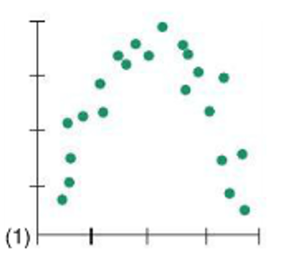
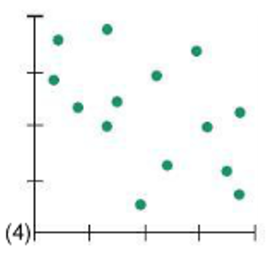
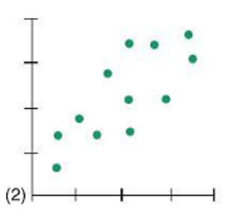
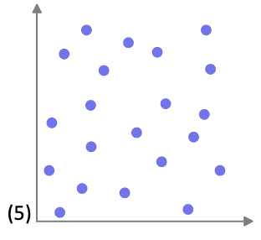
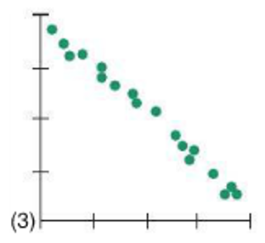
LCQ: Form
Problem: Determine the form for each of the following scatterplots.

Slide 10
LCQ: Form
Problem: Determine the form for each of the following scatterplots.
Curved → CLEAR curvature if we draw that line through the middle and if we trace the lower and upper edges
Curvature can also look like these where it kinda levels off, it doesn’t have to be the full rainbow
Linear → for the most part follows the straight diagonal line through the middle
Linear → dots more clearly follows a linear path
Linear-ish → not perfect ( or as clear as the others), but these dots generally follow straight line path with the middle and outside lines
Random → there is no patter here, just scattered everywhere

Slide 11
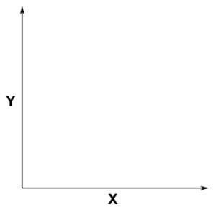
Direction
Direction
This refers to the direction of the association between the two variables
** This only applies to linear relationships as curved patterns can have both positive and negative directions in the same scatterplot, and random relationships are neither entirely positive or negative.
We can think of this as the slope of our line!
Positive Association
High values of one variable correspond (tend to occur with) to high values in the other variable, and
Low values of one variable correspond to low values in the other variable
So as the values of X increase, the values of Y tend to increase as well → Positive slope!
Variables are moving in the same general direction
Negative Association
High values of one variable correspond (tend to occur with) to low values of the other and vice versa
So as the values of X increase, the values of Y tend to decrease → Negative slope!
Variables are moving in the opposite general direction
No Association
There is no pattern or general trend
Low values of one variable can have both high or low values of the other; high values of one variable can have both high or low values of the other
Knowing if we have a high or low value of one variable gives us no indication whether the other variable’s value will be high or low
+
—

Slide 12
LCQ: Direction
Problem: Determine the direction for each of the following scatterplots.

Slide 13
LCQ: Direction
Problem: Determine the direction for each of the following scatterplots.
Starts positive, then goes negative; Not applicable → If we divide this plot in two, there are two different associations! This is because of the curved form.
We are only going to apply direction to linear forms, so this wouldn’t fit
Positive → definitely a positive slope to the “best” line we could draw. And we see the points shifting in the same direction, both increasing together
Negative → clear negative slope, Ys decrease as Xs increase (opposite directions
Positive → Still a positive slope to the line through the middle of the points
No association → there is no clear shift in the positive or negative direction, points kinda stay flat
It turns out the “best” line that we can draw here is a horizontal line cutting them in half, which would have a slope of zero!
We can think of no association as a slope of zero

Slide 14
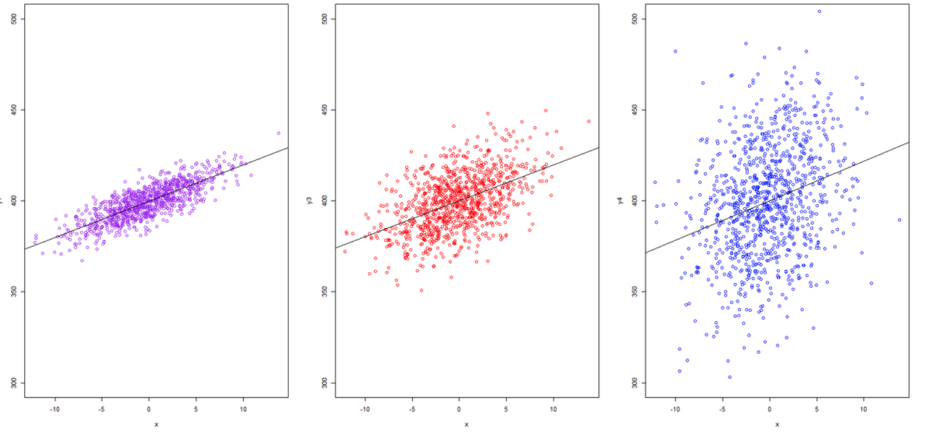
Strength
Strength
This refers to how strong the association is
In other words, how well the data fits the pattern?
We can think of this as how CLOSE the data are to our “best” line (the form)!
So how small or large the spread is around our “best” line
To visualize this, we can draw ovals centered on our “best” line that capture the majority of the points
Then look at how wide the oval is in the center perpendicular to the “best” line
** We are ONLY going to apply this to linear relationships
We are going to classify strength in three categories:
Larger spread
Smaller spread
High Strength (Strong)
The dots follow the linear pattern closely, with little scatter
Relatively small width of our oval
Moderate Association
The dots follow a general pattern, but not as tightly packed
Relatively medium width of our oval, still looks like an oval
Low Strength (Weak)
The dots do not appear to be following a pattern
Relatively large width of our oval, which starts looking more like a circle
https://bookdown.org/yshang/book/correlation.html

Slide 15
LCQ: Strength
Problem: Determine the strength for each of the following scatterplots.

Slide 16
LCQ: Strength
Problem: Determine the strength for each of the following scatterplots.
Strong, but not applicable → Points definitely follow this pattern very well, indicating a high strength. But because it has a curved form, we are not going to apply our definition of strength
Moderate → Fairly smallish width of our oval, not too much spread around the “best” line
Strong → very small spread around the “best” line. Points follow this pattern very closley
Moderate, maybe weak → medium-ish width of our oval. Hard to determine whether it would be moderate or weak. But
definitely weaker than (2),
Super weak→ almost have a circle / rectangular-ish shape here because of the lack of association, very large spread too

Slide 17
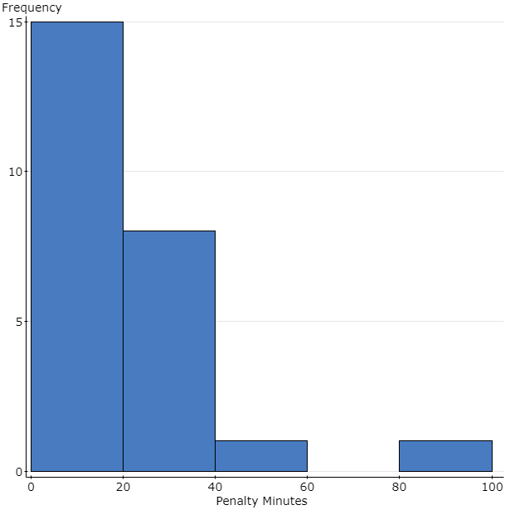
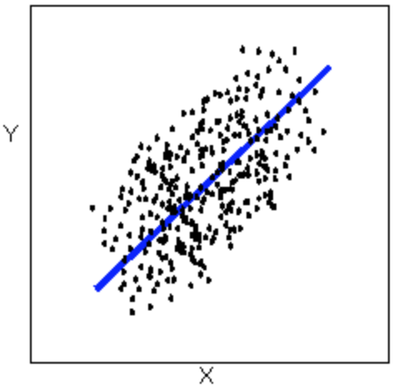
Outliers
Outliers
Outliers are points that do not follow (deviate from) the overall / general pattern
Recall outliers from histograms
Now we have two variables, so points can be an outlier in several different ways:
Only in the X direction → meaning the Y values are within the normal range, but the Xs are too different
Only in the Y direction → X values are within the normal range, but the Ys are too different
In both directions → Both X and Y are way different
This one and the upper right corner are at least in the path if we extend the best line, the other orange outliers are VERY different than the all other points
https://bolt.mph.ufl.edu/6050-6052/unit-1/case-q-q/scatterplots/

Slide 18
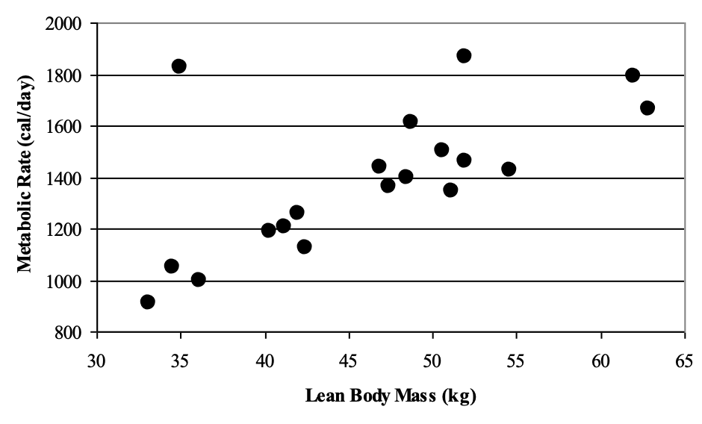
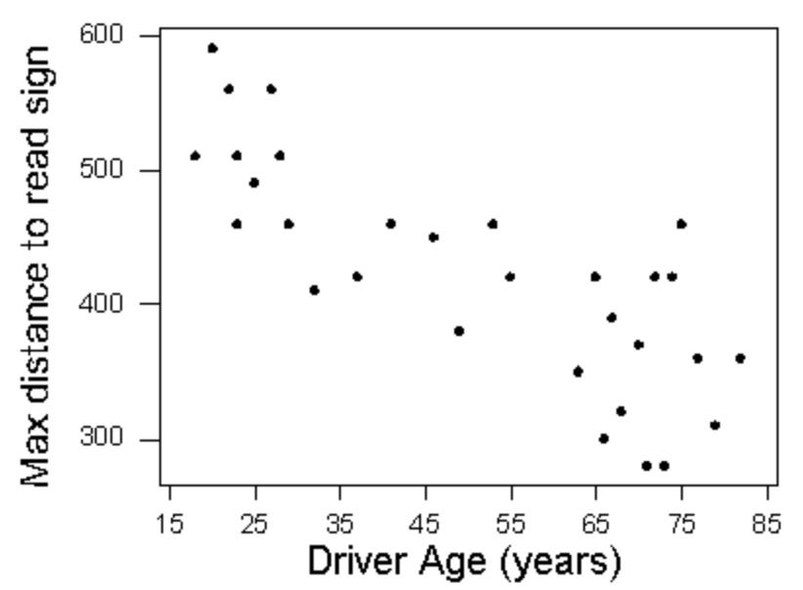
LCQ: Interpreting Scatterplots
Problem: Interpret the following scatterplots by discussing their Form, Direction, Strength and Outliers
a)
b)
https://courses.lumenlearning.com/wmopen-concepts-statistics/chapter/scatterplots-3-of-5/

Slide 19
LCQ: Interpreting Scatterplots
Problem: Interpret the following scatterplots by discussing their Form, Direction, Strength and Outliers
a)
All 4 pieces:
Linear form, positive direction, moderate (strong?) strength, appears to be at least one outlier
If we wanted to write this interpretation in a nice sentence with context, it could go like this:
There is a positive, moderate strength, linear relationship between lean body mass and metabolic rate. There appears to be one outlier at ≈ (35, 1850)
All 4 pieces:
Linear form, negative direction, moderate strength, and does not appear to be any outliers
If we wanted to write this interpretation in a nice sentence with context, it could go like this:
There is a negative, moderate strength, linear relationship between drivers age and max distance to read sign. There does not appear to be any outliers
b)
https://courses.lumenlearning.com/wmopen-concepts-statistics/chapter/scatterplots-3-of-5/

Slide 20
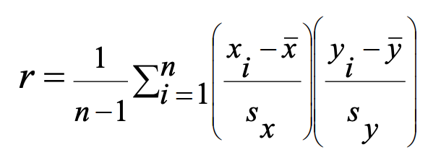
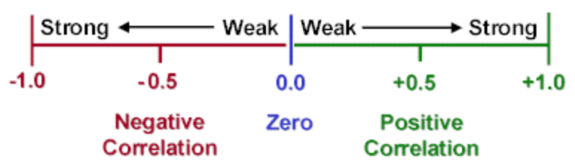
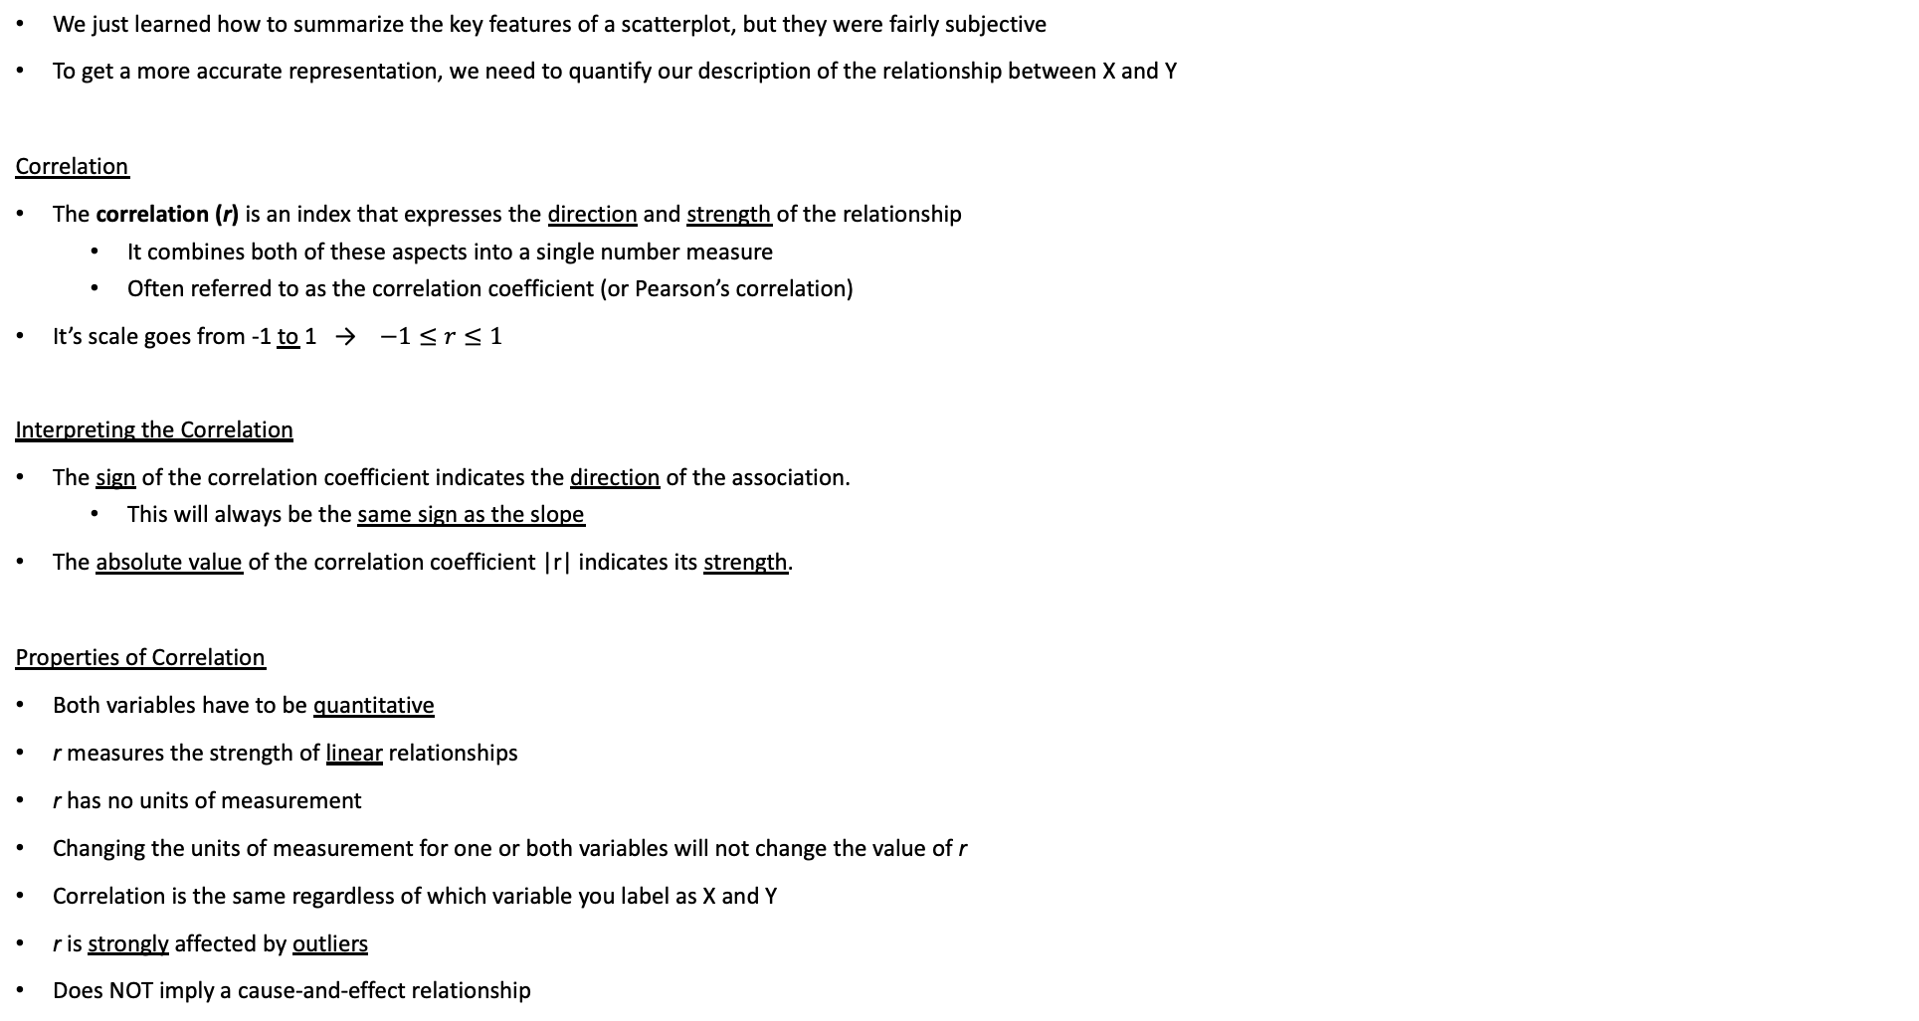
Correlation
We just learned how to summarize the key features of a scatterplot, but they were fairly subjective
To get a more accurate representation, we need to quantify our description of the relationship between X and Y
Correlation
The correlation (r) is an index that expresses the direction and strength of the relationship
It combines both of these aspects into a single number measure
Often referred to as the correlation coefficient (or Pearson’s correlation)
It’s scale goes from -1 to 1 → $−1≤r≤1$
Interpreting the Correlation
The sign of the correlation coefficient indicates the direction of the association.
This will always be the same sign as the slope
The absolute value of the correlation coefficient |r| indicates its strength.
Properties of Correlation
Both variables have to be quantitative
r measures the strength of linear relationships
r has no units of measurement
Changing the units of measurement for one or both variables will not change the value of r
Correlation is the same regardless of which variable you label as X and Y
r is strongly affected by outliers
Does NOT imply a cause-and-effect relationship
Formula
In words, we could describe this formula as an “average” of the product of the standardized values of the two variables.
Our calculator will do this for us!

Slide 21
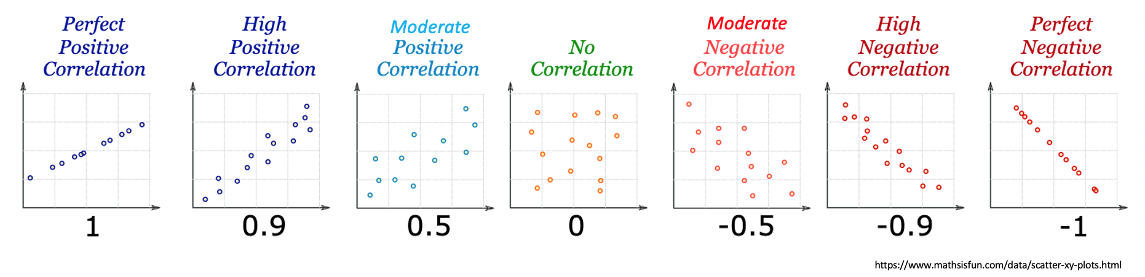
Correlation Visually
With perfect correlations, there is an EXACT equation describing the data: such as Y = 10 – 2X
If I know X, I automatically know where Y is going to be
As we decrease the strength of the correlation, there more and more uncertainty is introduced.
So maybe the equation becomes Y = 10 – 2X ± 1 and then decrease again and it becomes Y = 10 – 2X ± 3
Until ultimately as the correlation gets very close to zero, knowing X gives me no knowledge about Y

Slide 22
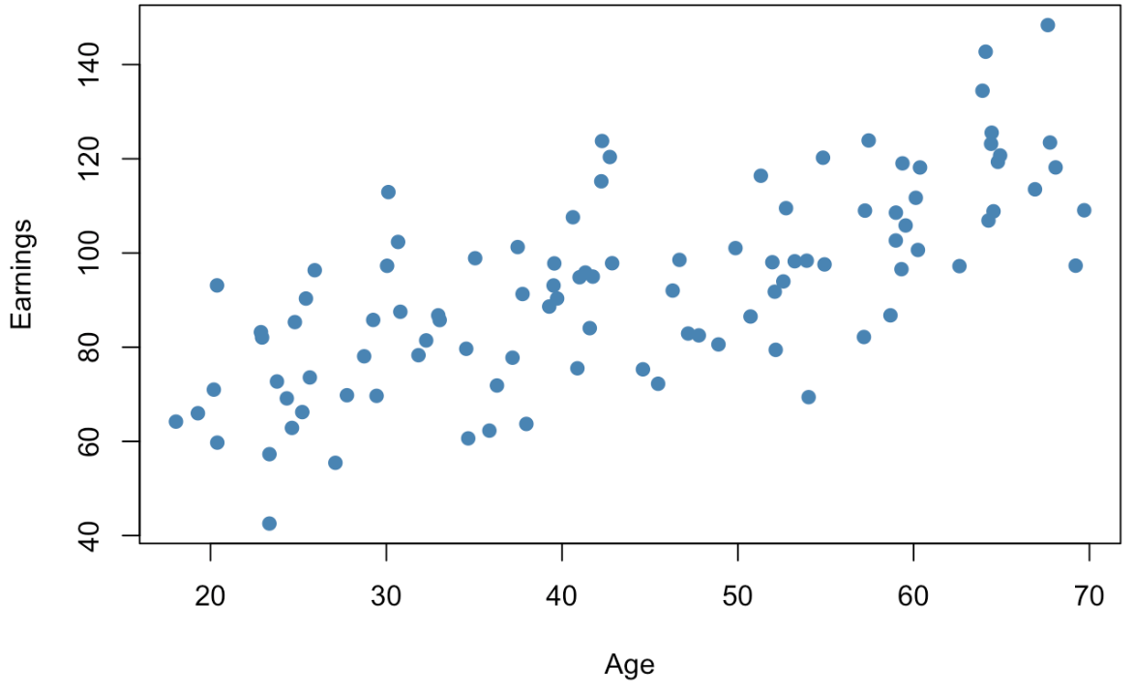
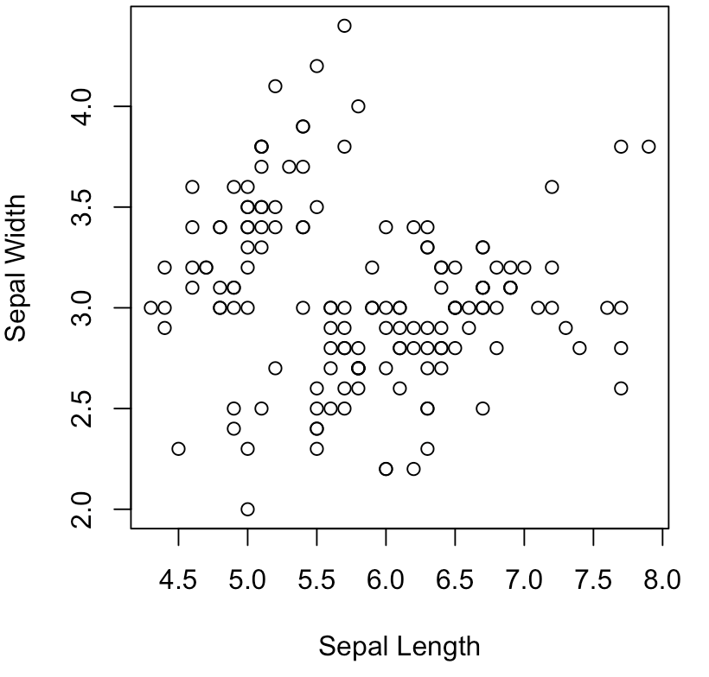
LCQ: Interpreting Correlation
How to Interpret Correlation
Have to mention the magnitude (which refers to the strength of linear relationship between X and Y) and direction (+/-)
And USE CONTEXT!!!
General structure → There is a < strong, moderate, weak >, < positive / negative > linear relationship between < X and Y >
Problem: Interpret the correlations for the each of the following scatterplots
a)
https://www.econometrics-with-r.org/3-7-scatterplots-sample-covariance-and-sample-correlation.html
b)
r = 0.706
r = -0.12

Slide 23
LCQ: Interpreting Correlation
How to Interpret Correlation
Have to mention the magnitude (which refers to the strength of linear relationship between X and Y) and direction (+/-)
And USE CONTEXT!!!
General structure → There is a < strong, moderate, weak >, < positive / negative > linear relationship between < X and Y >
Problem: Interpret the correlations for the each of the following scatterplots
a)
https://www.econometrics-with-r.org/3-7-scatterplots-sample-covariance-and-sample-correlation.html
b)
r = 0.706
r = -0.12
Options
1) There is a moderate, positive linear correlation between x and y → MISSING CONTEXT!!! Use the variable names at least
2) There is a moderate, positive linear correlation (relationship) between age an earnings → PERFECT now! Could also say ‘linear relationship’ instead of ‘correlation, both would be correct!
There is a weak, negative linear correlation between Sepal Length and Sepal Width → Remember the direction is based off the sign of the correlation and the strength is based on the magnitude (refer to the guidelines in the table!

Slide 24
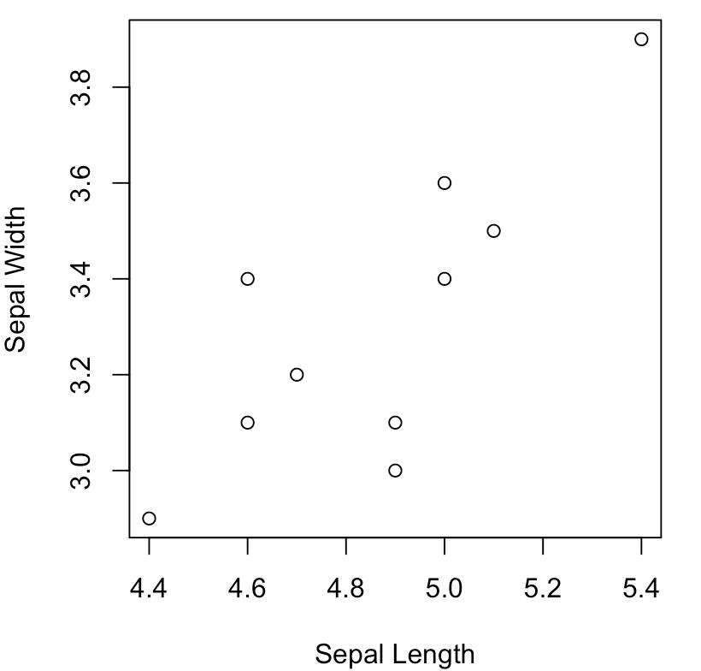
Using Calc - Correlation
*** One time setup: 2nd → Catalog → DiagnosticOn → Enter
GOAL: Calculate the Correlation Coefficient!
Enter data
X data in L₁
Y data in L₂
LinReg(a+bx)
Xlist = L₁
Ylist = L₂
FreqList: Leave blank
Store RegEQ: Leave blank
Calculate
X Y
STAT → CALC → LinReg(a+bx)
New point
Outliers Demonstration
Let’s change one data point to see the effects on the correlation:
9th observation: (4.4, 2.9) → (4.4, 3.8)
Now recalculate the correlation!

Slide 25
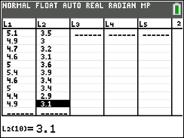
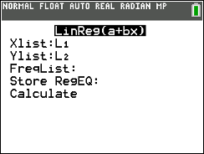
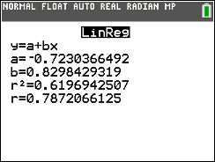
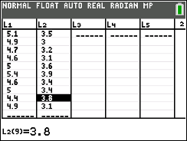
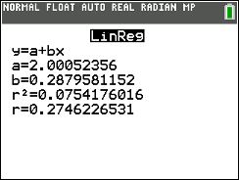
Using Calc - Correlation
*** One time setup: 2nd → Catalog → DiagnosticOn → Enter
r = 0.787
GOAL: Calculate the Correlation Coefficient!
Enter data
X data in L₁
Y data in L₂
LinReg(a+bx)
Xlist = L₁
Ylist = L₂
FreqList: Leave blank
Store RegEQ: Leave blank
Calculate
Impact on Correlation
Changing one point decreased the correlation by 0.512 (which is slightly more than a quarter of the total scale (total range is from -1 to 1, length 2)
This illustrates how sensitive the correlation can be, especially with small sample sizes
X Y
STAT → CALC → LinReg(a+bx)
r = Correlation
This is the only output we need for now!
Show work: LinReg(a+bx)(Xlist = L1, Ylist = L2)
New point
r = 0.275
Outliers Demonstration
Let’s change one data point to see the effects on the correlation:
9th observation: (4.4, 2.9) → (4.4, 3.8)
Now recalculate the correlation!

Slide 26
REGRESSION

Slide 27
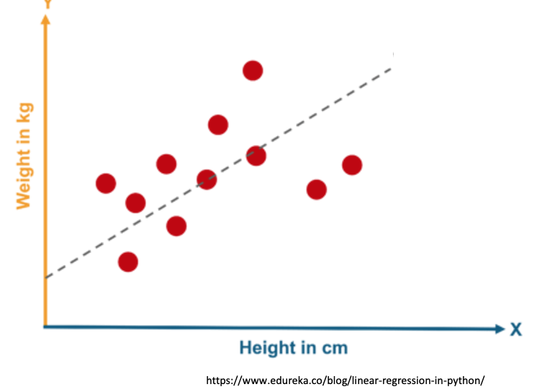
Motivation
In the case where our data does show evidence of a significant linear correlation, we would like to model that relationship!
Modeling the relationship will allow us to predict Y values for new X values.
The process is called linear regression.

Slide 28
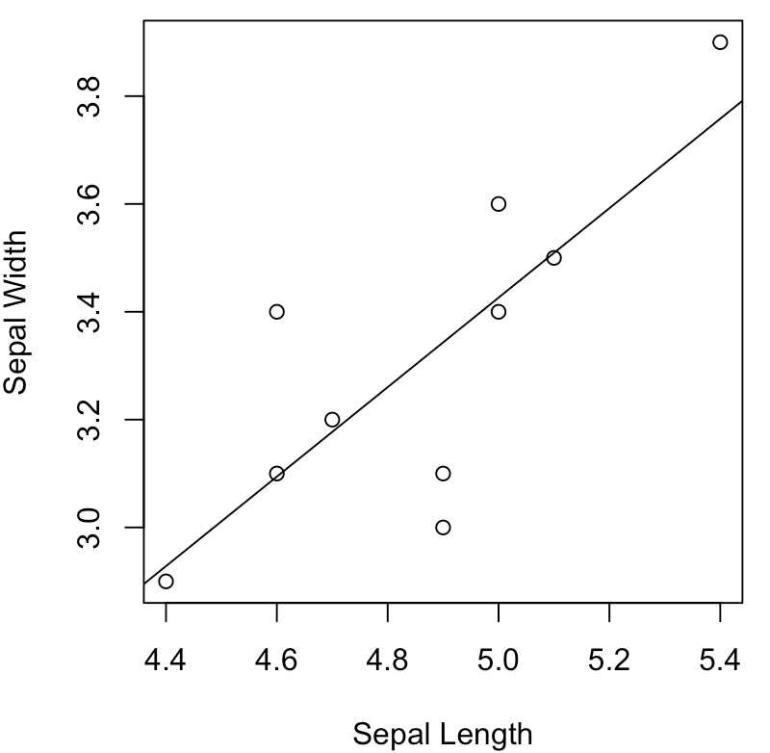
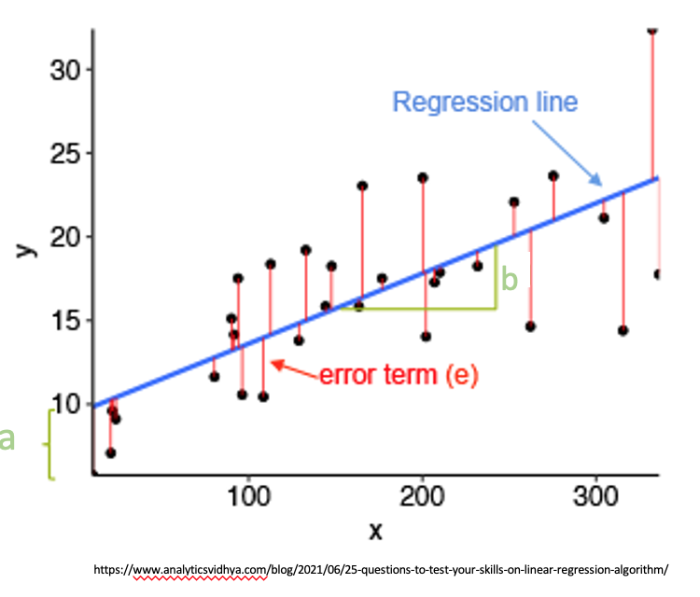
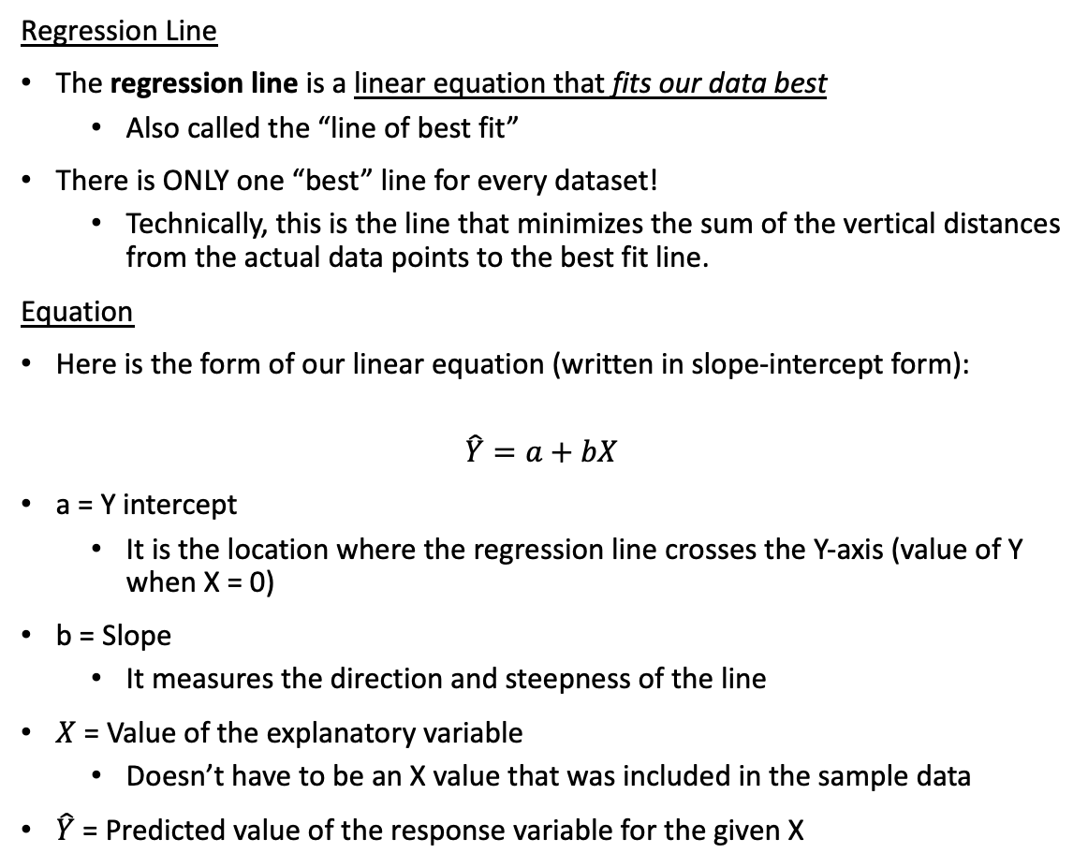
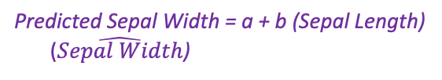
Regression Line
Regression Line
The regression line is a linear equation that fits our data best
Also called the “line of best fit”
There is ONLY one “best” line for every dataset!
Technically, this is the line that minimizes the sum of the vertical distances from the actual data points to the best fit line.
Equation
Here is the form of our linear equation (written in slope-intercept form):
$$\hat{Y}=a+bX$$
a = Y intercept
It is the location where the regression line crosses the Y-axis (value of Y when X = 0)
b = Slope
It measures the direction and steepness of the line
$X$ = Value of the explanatory variable
Doesn’t have to be an X value that was included in the sample data
$\hat{Y}$ = Predicted value of the response variable for the given X
Predicted Sepal Width = a + b (Sepal Length)
($\hat{Sepal Width}$)
It’s important to get the X and Y variables correct or else our equation’s variables will be backwards!

Slide 29
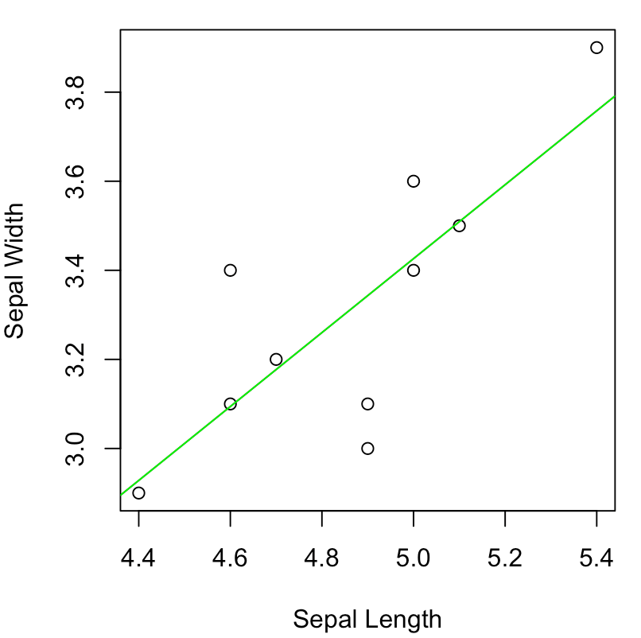
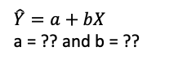
Using Calc – Regression Line
$\hat{Y}=a+bX$
a = ?? and b = ??
X Y
GOAL: Calculate the Regression Line!
Enter data
X data in L₁
Y data in L₂
LinReg(a+bx)
Xlist = L₁
Ylist = L₂
FreqList: Leave blank
Store RegEQ: Leave blank
Calculate
STAT → CALC → LinReg(a+bx)
New point
Outliers Demonstration
Let’s change one data point to see the effects on the regression line:
9th observation: (4.4, 2.9) → (4.4, 3.8)
Now recalculate the equation!

Slide 30
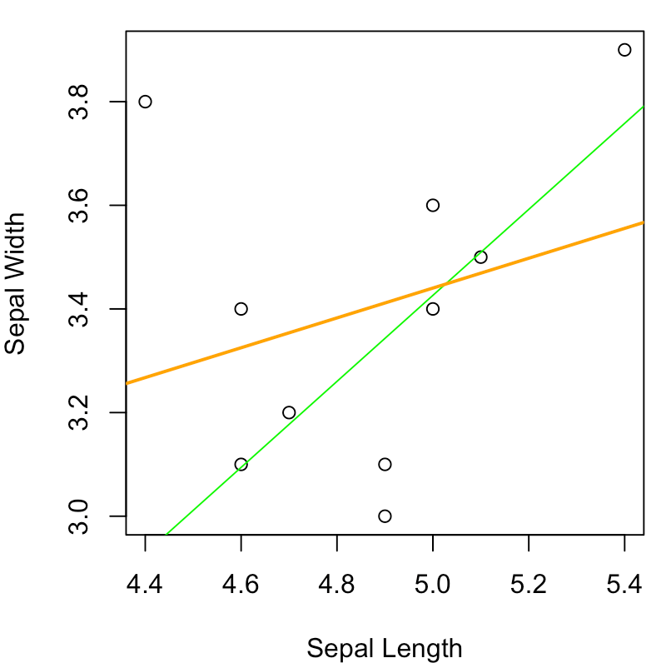
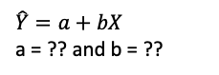
Using Calc – Regression Line
X Y
GOAL: Calculate the Regression Line!
Enter data
X data in L₁
Y data in L₂
LinReg(a+bx)
Xlist = L₁
Ylist = L₂
FreqList: Leave blank
Store RegEQ: Leave blank
Calculate
$\hat{Y}=a+bX$
a = ?? and b = ??
STAT → CALC → LinReg(a+bx)
Calculator Output
a = intercept b₀
b = slope b₁
Regression Equation: $\hat{Y}=−0.723+0.83X$
BIG difference between the two regression equations just from changing the one point
NOTE that this change is kinda amplified because of the small sample size
But nonetheless illustrates the effects of outliers on regression as well as correlation
Show work: LinReg(a+bx)(Xlist = L1, Ylist = L2)
New point
Outliers Demonstration
Let’s change one data point to see the effects on the regression line:
9th observation: (4.4, 2.9) → (4.4, 3.8)
Now recalculate the equation!
New Regression Equation: $\hat{Y}=2.001+0.288X$

Slide 31
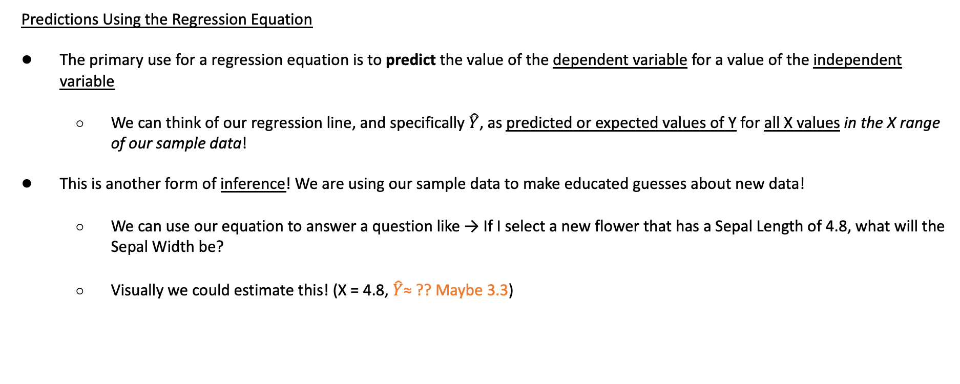
Predicting
Predictions Using the Regression Equation
The primary use for a regression equation is to predict the value of the dependent variable for a value of the independent variable
We can think of our regression line, and specifically $\hat{Y}$, as predicted or expected values of Y for all X values in the X range of our sample data!
This is another form of inference! We are using our sample data to make educated guesses about new data!
We can use our equation to answer a question like → If I select a new flower that has a Sepal Length of 4.8, what will the Sepal Width be?
Visually we could estimate this! (X = 4.8, $\hat{Y}$≈ ?? Maybe 3.3)
3.3 ≈

Slide 32
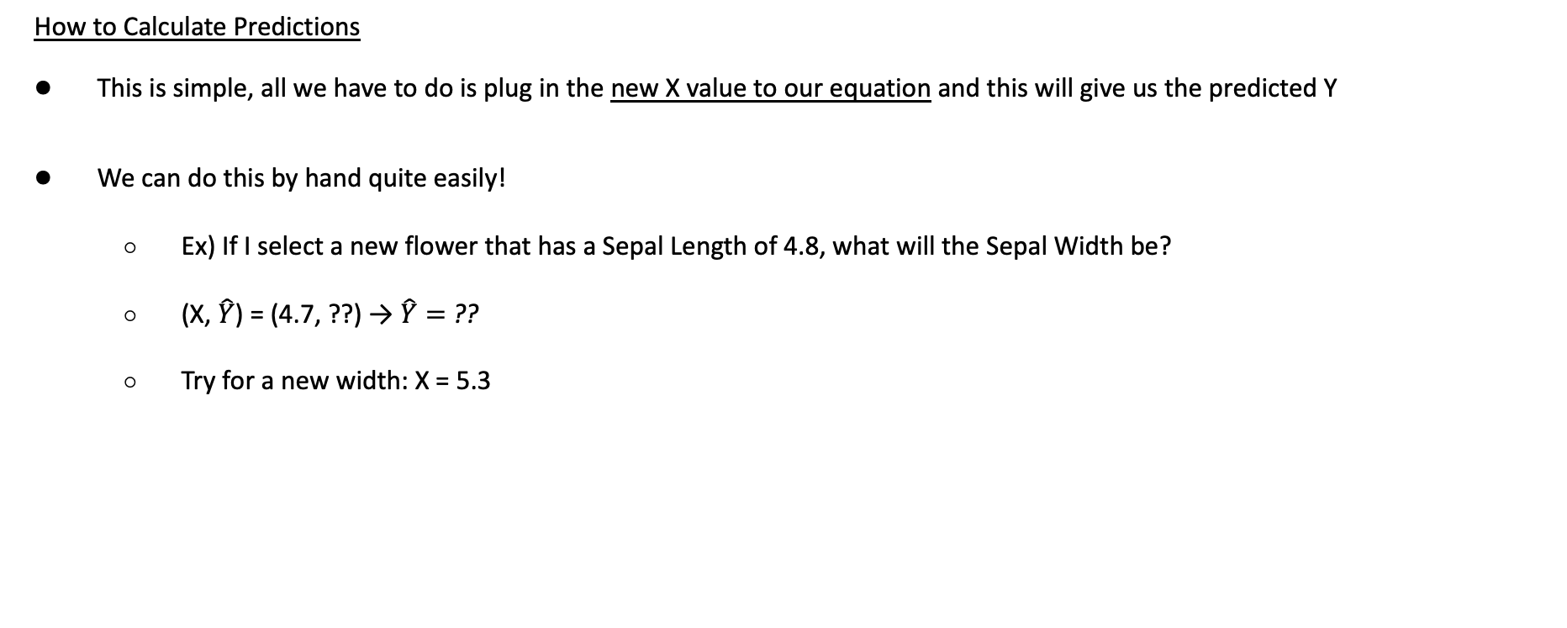
Calculating Predictions
How to Calculate Predictions
This is simple, all we have to do is plug in the new X value to our equation and this will give us the predicted Y
We can do this by hand quite easily!
Ex) If I select a new flower that has a Sepal Length of 4.8, what will the Sepal Width be?
(X, $\hat{Y}$) = (4.7, ??) → $\hat{Y}=$??
Try for a new width: X = 5.3
Overestimate or Underestimate
By comparing our prediction to the observed value, we can see if our model over or underestimated
At X = 5, which point was overestimated by our model and which point was underestimated?
?? =

Slide 33
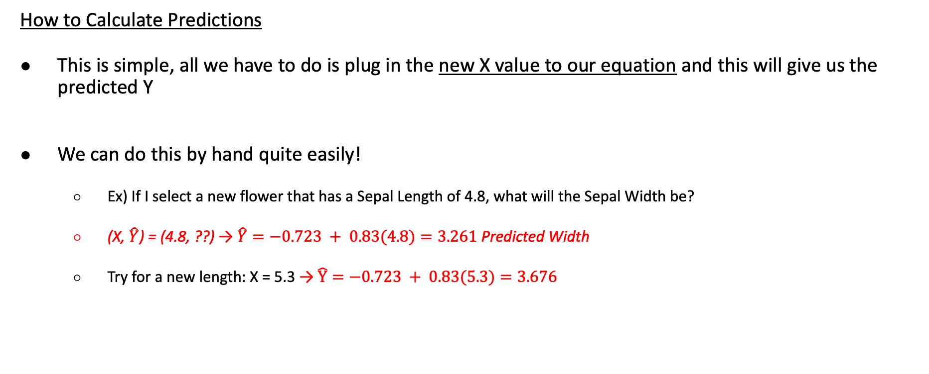
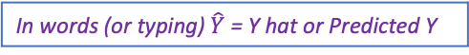
Calculating Predictions
How to Calculate Predictions
This is simple, all we have to do is plug in the new X value to our equation and this will give us the predicted Y
We can do this by hand quite easily!
Ex) If I select a new flower that has a Sepal Length of 4.8, what will the Sepal Width be?
(X, $\hat{Y}$) = (4.8, ??) → $\hat{Y}=−0.723 + 0.83(4.8)=3.261$ Predicted Width
Try for a new length: X = 5.3 → $\hat{Y}=−0.723 + 0.83(5.3)=3.676$
Regression Equation: $\hat{Y}=−0.723+0.83X$
In words (or typing) $\hat{Y}$= Y hat or Predicted Y
Overestimate or Underestimate
By comparing our prediction to the observed value, we can see if our model over or underestimated
At X = 5, for one data point we overestimated (our regression line is above the actual value) and for the other we underestimated (the regression line is below the actual value)
TIP: Over / Under is from the perspective of the model
Underestimated
3.26 =
Overestimated

Slide 34
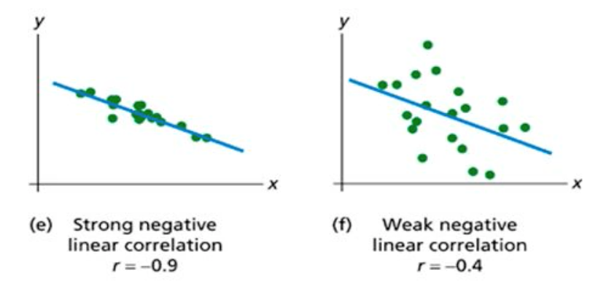

Evaluation Predictions
Evaluating Predictions
In addition to fitting the line, we also want to think about how good our predictions will be based on this line
One way we can evaluate the quality of our predictions (so how much we can trust them) is by the Correlation
High Correlation
Indicates that there is a strong linear relationship between the two variables
And therefore the line will fit well and the predictions will be accurate.
Low Correlation
Indicates that there is a weak linear relationship between the two variables
And therefore the line will not fit well and the predictions will not be accurate
https://slideplayer.com/slide/6204684/

Slide 35

Interpolating vs Extrapolating
When we predict, we are actually doing one of two things (one is good, one is bad):
Interpolation
Interpolation results when the X value of interest falls between given values of X in our original data set
Generally interpolation is considered a safe prediction method because we have already shown that our data behaves in a linear way within the range that we used to come up with the regression equation
Extrapolation
Extrapolation results when the X value of interest falls outside the range of values for X in our original data set
Extrapolation is considered riskier than interpolation because we have no way of knowing what the behavior of the data will be outside of the range we studied.
It is a BIG assumption to think the regression line will continue in the EXACT same pattern (It could level off, or curve, or anything)
Interpolation
Extrapolation
Extrapolation
https://bolt.mph.ufl.edu/6050-6052/unit-1/case-q-q/scatterplots/

Slide 36
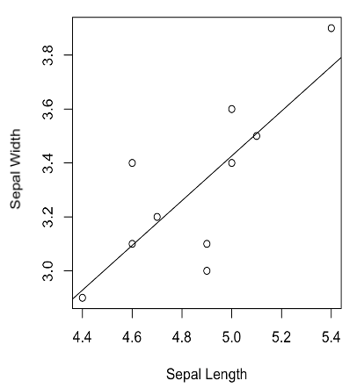
LCQ: Interpolating vs Extrapolating
Problem: Determine if the following predictions are interpolating or extrapolating. Then calculate the prediction.
Predict the Sepal Width for a Sepal Length = 4.0
Predict the Sepal Width for a Sepal Length = 5.1
Predict the Sepal Width for a Sepal Length = 5.5
Regression Equation: $\hat{Y}=−0.723+0.83X$

Slide 37
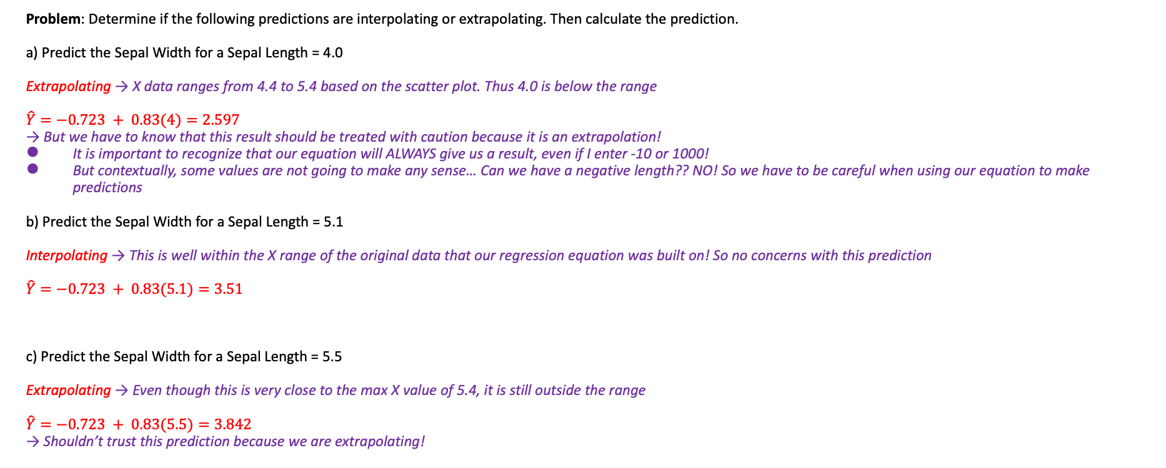
LCQ: Interpolating vs Extrapolating
Problem: Determine if the following predictions are interpolating or extrapolating. Then calculate the prediction.
a) Predict the Sepal Width for a Sepal Length = 4.0
Extrapolating → X data ranges from 4.4 to 5.4 based on the scatter plot. Thus 4.0 is below the range
$\hat{Y}=−0.723 + 0.83(4)=2.597$
→ But we have to know that this result should be treated with caution because it is an extrapolation!
It is important to recognize that our equation will ALWAYS give us a result, even if I enter -10 or 1000!
But contextually, some values are not going to make any sense… Can we have a negative length?? NO! So we have to be careful when using our equation to make predictions
b) Predict the Sepal Width for a Sepal Length = 5.1
Interpolating → This is well within the X range of the original data that our regression equation was built on! So no concerns with this prediction
$\hat{Y}=−0.723 + 0.83(5.1)=3.51$
c) Predict the Sepal Width for a Sepal Length = 5.5
Extrapolating → Even though this is very close to the max X value of 5.4, it is still outside the range
$\hat{Y}=−0.723 + 0.83(5.5)=3.842$
→ Shouldn’t trust this prediction because we are extrapolating!
Regression Equation: $\hat{Y}=−0.723+0.83X$

